Slide 1
ARTIFICIAL INTELLIGENCE
2017/2018 Semester 1
Introduction: Chapter 1

Slide 2
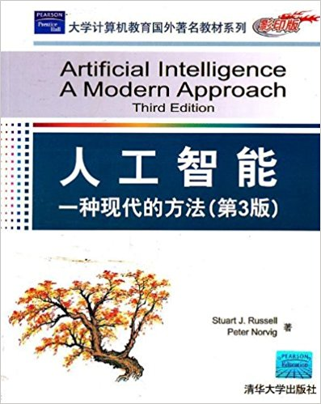

CS410
Course home page: http://bcmi.sjtu.edu.cn/ai/
  schedule, lecture notes, tutorials, assignment, grading, office hours, etc.
Textbook: S. Russell and P. Norvig Artificial Intelligence: A Modern Approach Prentice Hall, 2003, Second Edition
Lecturer: Liqing Zhang
Grading: Assignment +Class Test(30%), Projects (30%), Final report (40%)

Slide 3
Course overview
Introduction and Agents (chapters 1,2)
Search (chapters 3,4,5,6)
Logic (chapters 7,8,9)
Planning (chapters 11,12)
Uncertainty (chapters 13,14)
Learning (chapters 18,20)
Natural Language Processing (chapter 22,23)

Slide 4
Outline
Course overview
What is AI?
A brief history
The state of the art

Slide 5
What is AI?
Artificial Intelligence (AI)
  Intelligent behavior in artifacts
  “Design computer programs to make computers smarter”
  “Study of how to make computers do things at which, at the moment, people are better”
Intelligent behavior
  Perception, reasoning, learning, decision, communicating, acting in complex environments
Long term goals of AI
  Develop machines that do things as well as humans can or possibly even better
  Understand intelligent behaviors

Slide 6
What Is AI?
Can machines think?
  Depend on the definitions of “machine”, “think”, “can”
“Can”
  Can machines think now or someday?
  Might machines be able to think theoretically or actually?
“Machine”
  E6 Bacteriophage: Machine made of proteins
  Searle’s belief
    What we are made of is fundamental to our intelligence
    Thinking can occur only in very special machines – living ones made of proteins

Slide 7
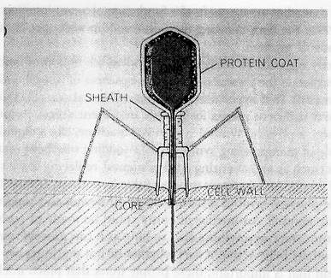
What Is AI?
Figure 1.1 Schematic Illustration of E6 Bacteriophage

Slide 8
What is AI?
Views of AI fall into four categories:
Thinking humanly Thinking rationally
Acting humanly Acting rationally
The textbook advocates "acting rationally"

Slide 9

Acting humanly: Turing Test
Turing (1950) "Computing machinery and intelligence":
"Can machines think?" → "Can machines behave intelligently?"
Operational test for intelligent behavior: the Imitation Game
Predicted that by 2000, a machine might have a 30% chance of fooling a lay person for 5 minutes
Suggested major components of AI: knowledge, reasoning, language understanding, learning

Slide 10
Thinking humanly: cognitive modeling
1960s "cognitive revolution": information-processing psychology
Requires scientific theories of internal activities of the brain
-- How to validate? Requires
  1) Predicting and testing behavior of human subjects (top-down)
  or 2) Direct identification from neurological data (bottom-up)
Both approaches (roughly, Cognitive Science and Cognitive Neuroscience), are now distinct from AI

Slide 11
Thinking rationally: "laws of thought"
Aristotle: what are correct arguments/thought processes?
Several Greek schools developed various forms of logic: notation and rules of derivation for thoughts; may or may not have proceeded to the idea of mechanization
Direct line through mathematics and philosophy to modern AI
Problems:
  Not all intelligent behavior is mediated by logical deliberation
  What is the purpose of thinking? What thoughts should I have?

Slide 12
Acting rationally: rational agent
Rational behavior: doing the right thing
The right thing: that which is expected to maximize goal achievement, given the available information
Doesn't necessarily involve thinking – e.g., blinking reflex – but thinking should be in the service of rational action

Slide 13
Rational agents
An agent is an entity that perceives and acts
Abstractly, an agent is a function from percept histories to actions:
[f: P* → A]
For any given class of environments and tasks, we seek the agent (or class of agents) with the best performance
Remark: computational limitations make perfect rationality unachievable
  → design best program for given machine resources

Slide 14
AI prehistory
Philosophy Logic, methods of reasoning, mind as physical
system foundations of learning, language,
rationality
Mathematics Formal representation and proof algorithms,
computation, (un)decidability, (in)tractability,
probability
Economics Utility, Decision theory
Neuroscience Physical substrate for mental activity
Psychology Phenomena of perception and motor control,
experimental techniques
Computer Building fast computers
engineering
Control theory Design systems that maximize an objective
function over time
Linguistics Knowledge representation, grammar

Slide 15
Abridged history of AI
1943 McCulloch & Pitts: Boolean circuit model of brain
1950 Turing's "Computing Machinery and Intelligence"
1956 Dartmouth meeting: "Artificial Intelligence" adopted
1952—69 Look, Ma, no hands!
1950s Early AI programs, including Samuel's checkers
program, Newell & Simon's Logic Theorist,
Gelernter's Geometry Engine
1965 Robinson's complete algorithm for logical reasoning
1966—73 AI discovers computational complexity
Neural network research almost disappears
1969—79 Early development of knowledge-based systems
1980-- AI becomes an industry
1986-- Neural networks return and became popular
1987-- AI becomes a science
1995-- The emergence of intelligent agents

Slide 16
State of the Art
Deep Blue defeated the reigning world chess champion Garry Kasparov in 1997
Proved a mathematical conjecture (Robbins conjecture) unsolved for decades (1996 by W. McCune)
No hands across America (driving autonomously 98% of the time from Pittsburgh to San Diego)
During the 1991 Gulf War, US forces deployed an AI logistics planning and scheduling program that involved up to 50,000 vehicles, cargo, and people
NASA's on-board autonomous planning program controlled the scheduling of operations for a spacecraft
Proverb solves crossword puzzles better than most humans

Slide 17
Computer Sci. and Brain Sci.
Information Processing in Digital Computer
Computing based on Logic
CPU and Storage: Separated
Data Processing & Storage: Simple
Intelligent Information Processing: Complicated and Slow
Cognitive capability: Weak
Information Process Mode:
Logic – Information – Statistics
Information Processing in
the Brain
Computing based on Statistics
CPU and Storage: Unified
Data Processing & Storage: Unknown
Intelligent Information Processing:
Simple and Fast
Cognitive capability: Strong
Information Process Mode:
Statistics －concepts－logic

Slide 18
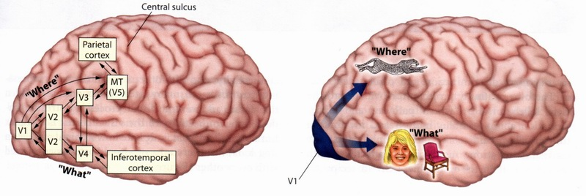
Visual Information Processing
Fig.2.29
‘Where’: the motion and spatial location
‘What’: the detailed features, form, and object identity

Slide 19
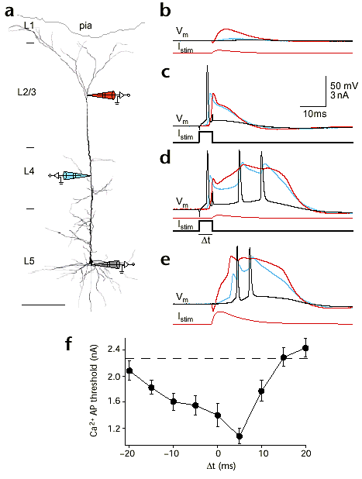
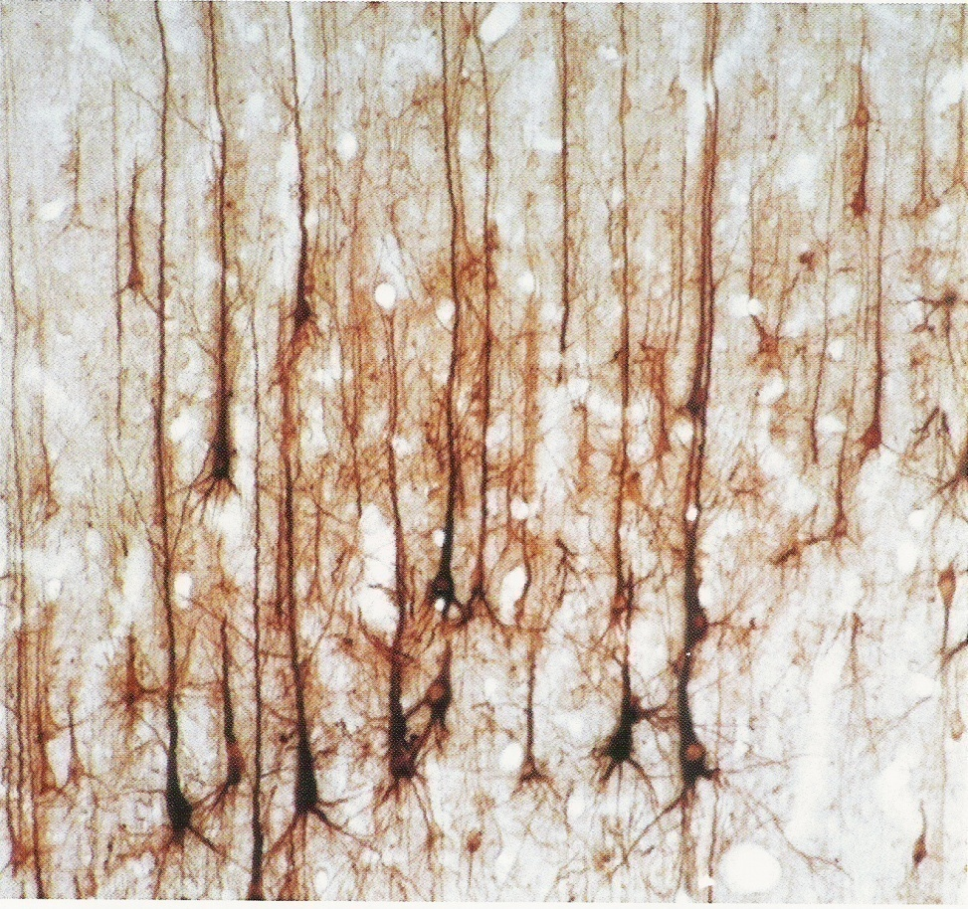
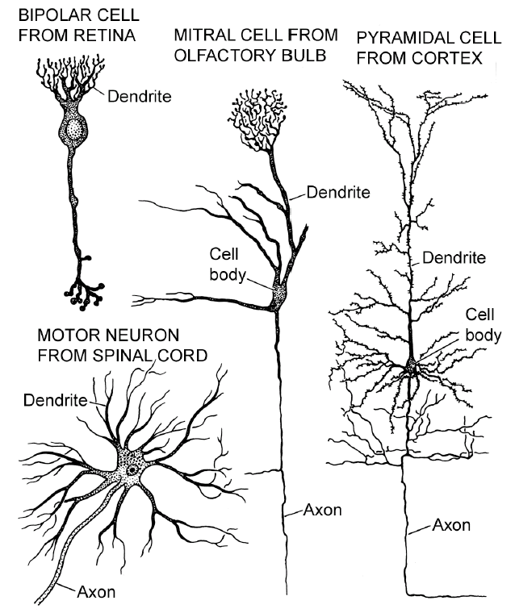
Biological Neurons

Slide 20
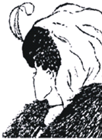

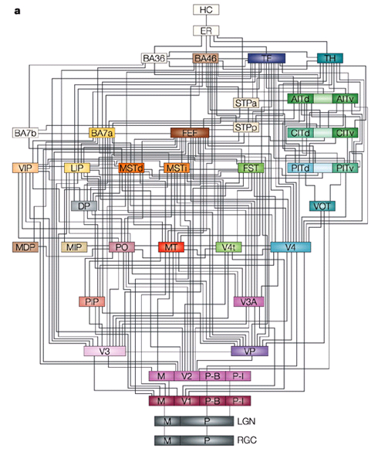
Challenges

Slide 21
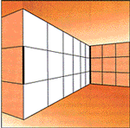
Human Vision (1)

Slide 22
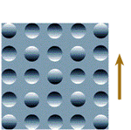
Human Vision (2)

Slide 23

Human Vision (3)

Slide 24
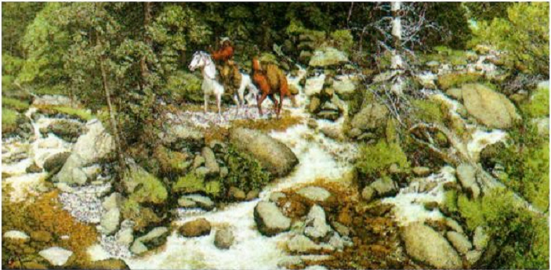
Relax for a while
Test：How many human faces in the picture？

Slide 25
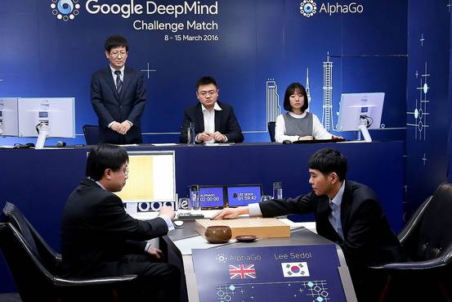
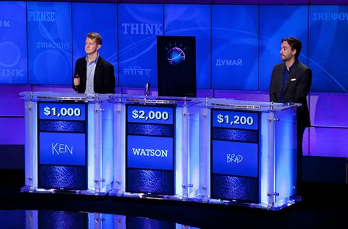
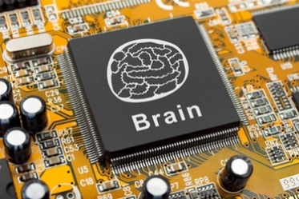
人工智能简史
2016 Alpha GO
2012 深度卷积网络, Le Kun
2011 IBM Watson
2005 深度学习, Hinton
1996 Robbins 猜想
1986-神经网络
1965 Robinson‘s 完备算法
1957 感知器, Rosenblatt
1956人工智能定义Dartmouth workshop
1943神经元模型 McCulloch&Pitts

Slide 26
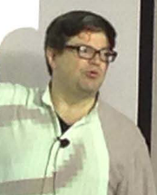
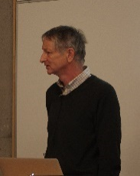
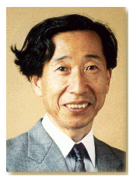

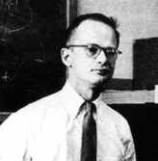

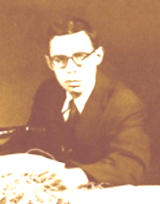
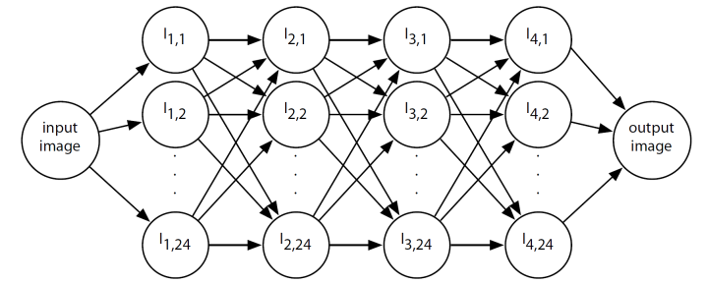
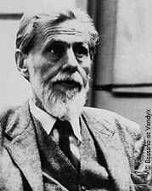
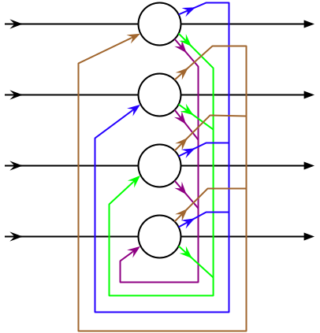
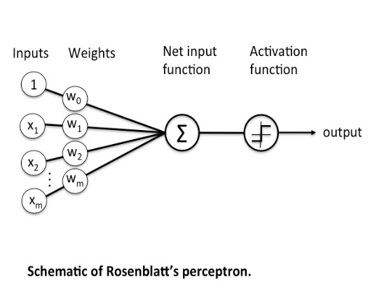
类脑模型进展
CNN, 1998, 2012
RNN, 1982, 2013
S. Amari 1967
S. Grossberg
Deep learning, 2005, 2009
F. Rosenblatt
Hopfield Neural network（1982）
The multilayer perceptron(1972)
Fukushima, Neocognitron(1980)
The perceptron algorithm
（1957）
McCulloch－Pitts′ neuron model
（ 1943 ）

Slide 27
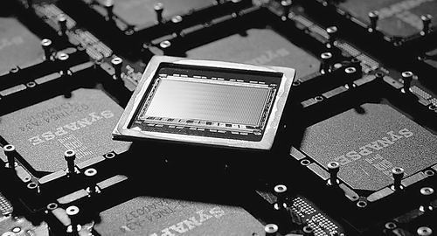

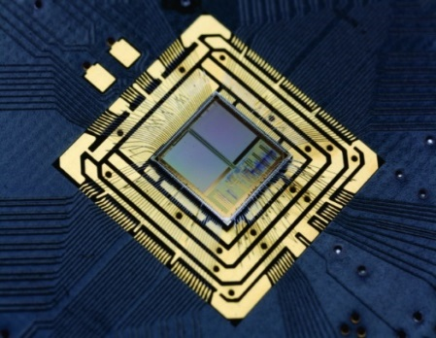
类脑模型进展
2012年， IBM发布了TrueNorth芯片，包含54亿个晶体管，集成了2560万个神经突触。Synapse
2014年 发布新版本
2013瑞士苏黎世大学、联邦理工学院(ETH Zurich )神经信息学研究所(INI)的教授贾科莫·因迪韦里；最新研制一款微芯片,具备大脑信息处理能力
2014 Berlin and Heidelberg Computing With Silicon Neurons: Scientists Use Artificial Nerve Cells

Slide 28
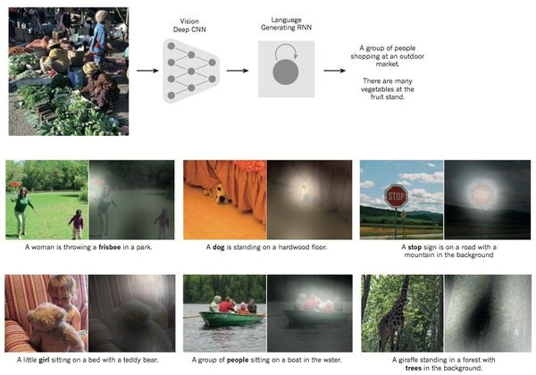
深度典型实例 – 图像标注

Slide 29
IBM再次赢得“人机大战”
在美国最受欢迎的智力竞猜节目播放的2月14日-2月16日期间，IBM超级电脑Watson其中击败了两名人类选手，最终获得胜利。
2月14日-2月16日- IBM 高调推出超级计算机 Watson，目标是建造一个能与人类回答问题能力匹敌的计算系统，在比赛中，参赛者必须要回答一系列的问题，主要涉及历史，文学，政治，电影，流行文化和科学。
这要求计算机具有足够的速度、精确度和置信度，并且能使用人类的自然语言回答问题。
挑战——回答 Jeopardy 比赛中的题目需要分析人类语言中微妙的含义、讽刺口吻、谜语等，这些通常是人类擅长的方面，一直以来计算机在这方面毫无优势可言。

Slide 30
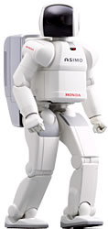
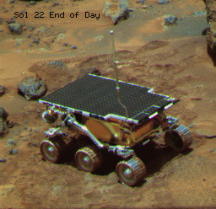
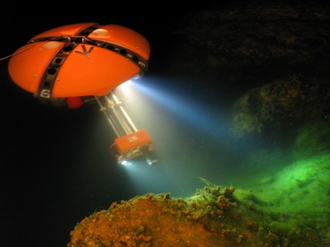
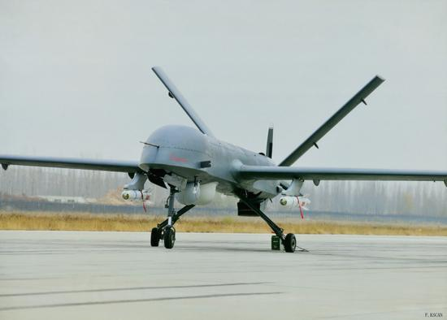
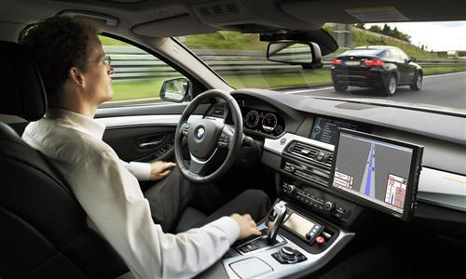
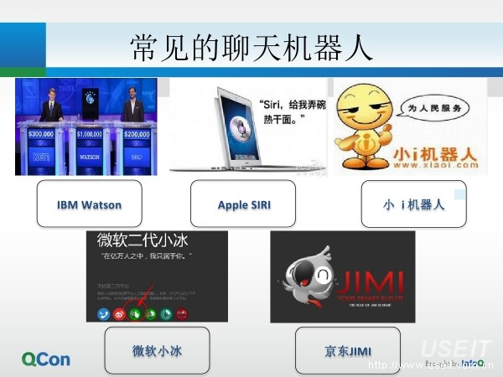
Intelligent Systems

Slide 31
Home work
To write a short report on your personal interests in the field of AI.

Slide 32
围棋课程设计报告提要
项目任务分工简介
  每一个同学在项目分工、工作量分配
课题实现的技术路线
采用方法简介（除了本课程的算法，是否还采用了其他算法）
实验结果分析
结论与感想

